Slide 1
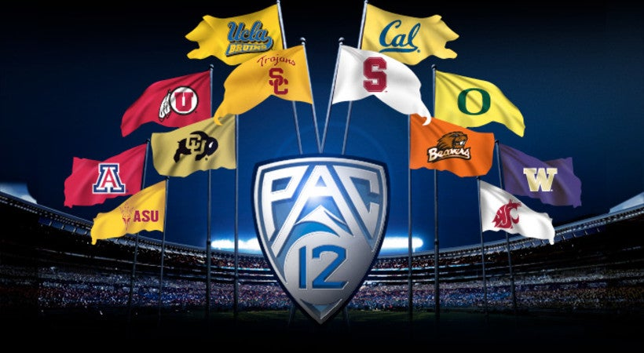
CDATA
presents…

Slide 2
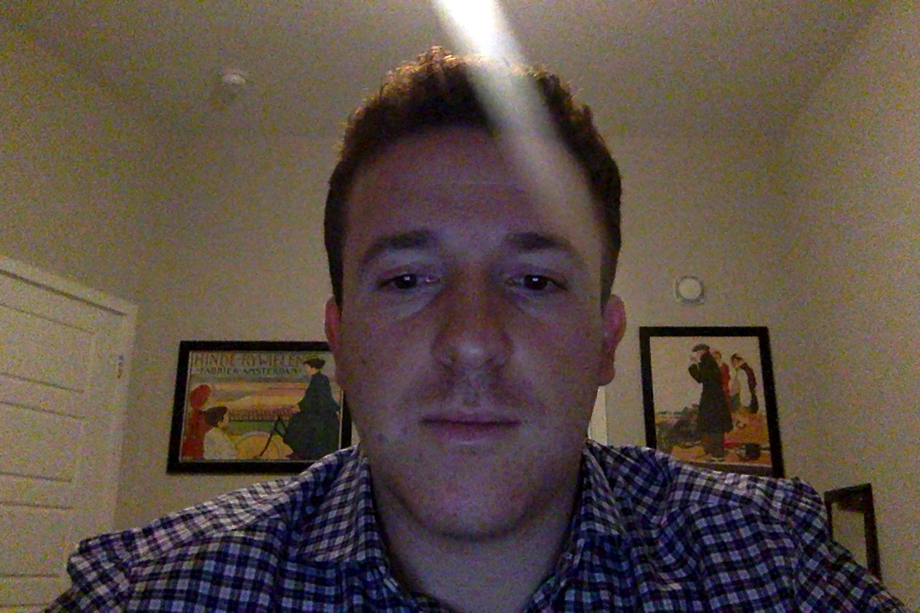
Recruiting Grade Impact on WIN% in PAC12 Football

Slide 3
THE DATA
2006-2019 college football recruiting classes, each player labeled from 1 to 5 stars depending on their skillset
Year by year analysis of the PAC12 division using Tableau
https://public.tableau.com/profile/chloe1341#!/vizhome/Pac12_SchoolBars/Dashboard?publish=yes
https://public.tableau.com/profile/chloe1341#!/vizhome/Pac12_College_Lookup/College_Player_CrossTab?publish=yes
https://public.tableau.com/profile/chloe1341#!/vizhome/CollegeWinningPercent2/WinningPercent?publish=yes
Also used Tableau to clean our data and extract CSV files
Merged WIN% data for each team with recruiting data to obtain final dataset used in our Machine Learning

Slide 4
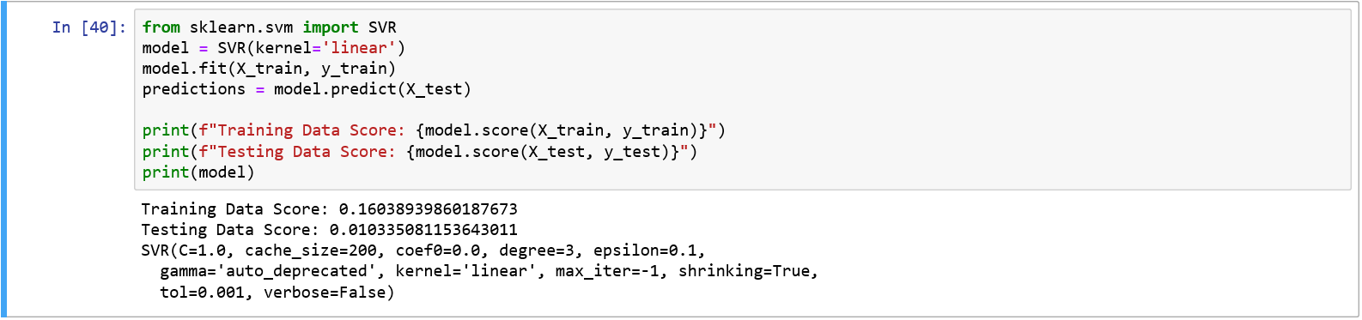
THE ANALYSIS – 1st Year Impact
Trained our dataset correlating the number of starred recruits on a team with that given team’s WIN%
From our findings, the first year impact of starred recruits on a team’s WIN% minimal at best

Slide 5
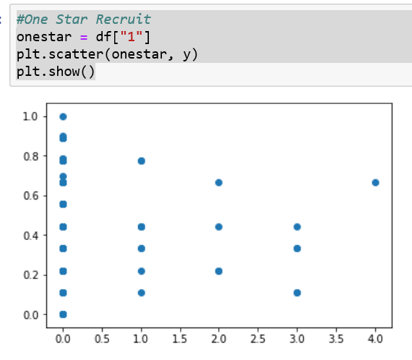
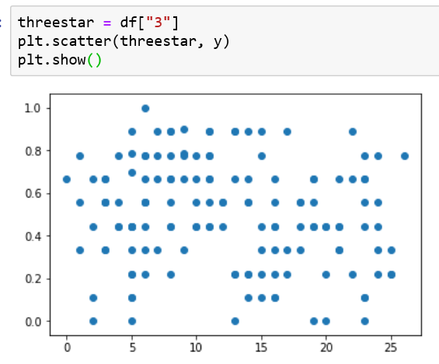
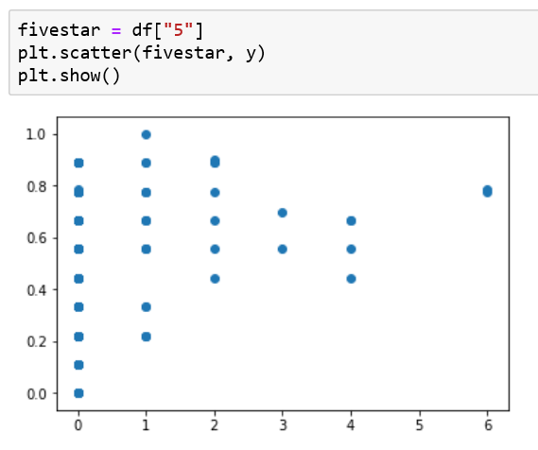
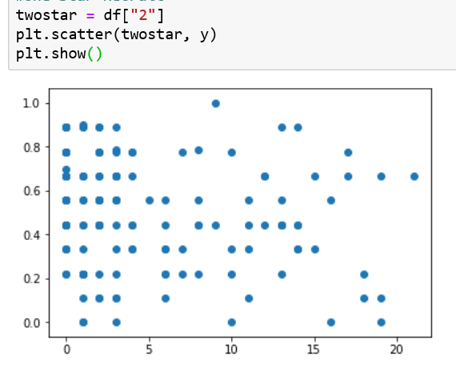
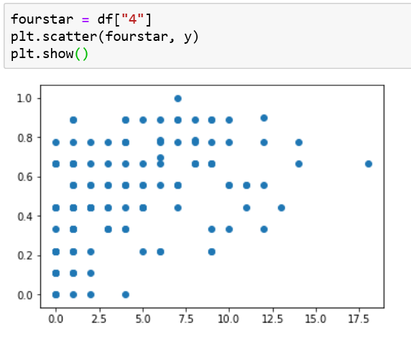
THE ANALYSIS – 1st Year Impact
We separated each starred recruit and created scatter plots to analyze their impact separately

Slide 6
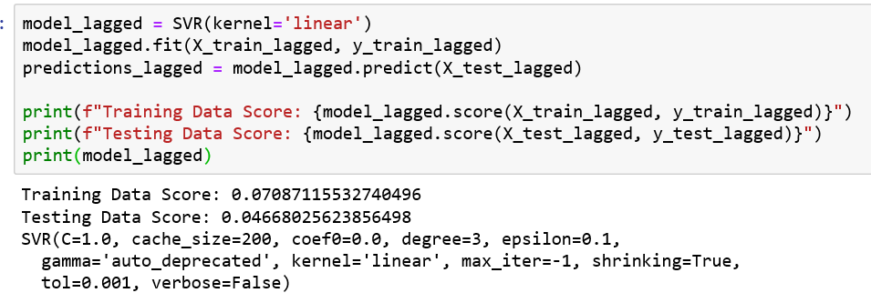
THE ANALYSIS – 3rd Year Impact
We then analyzed if our scores would increase in a 3 year lagged model since NCAA rules regulate playing a minimum of 3 years
Even though our testing scores increased, our training data decreased, suggesting no relevant correlation within a lagged model

Slide 7
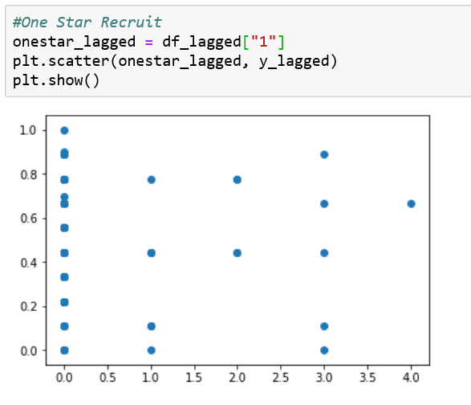
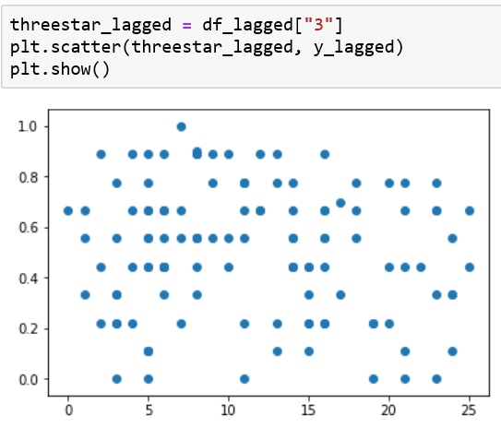
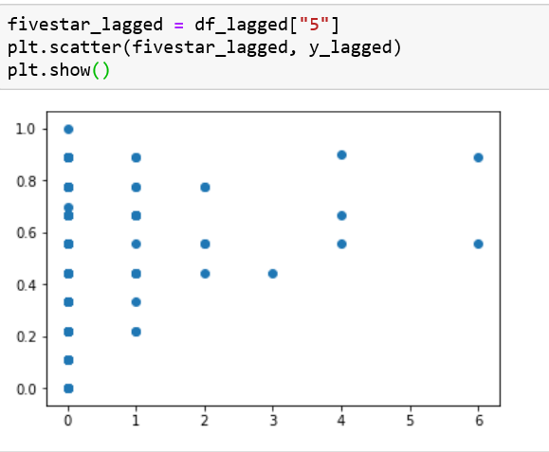
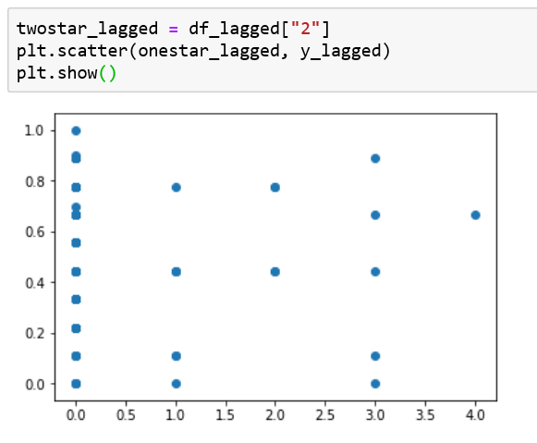
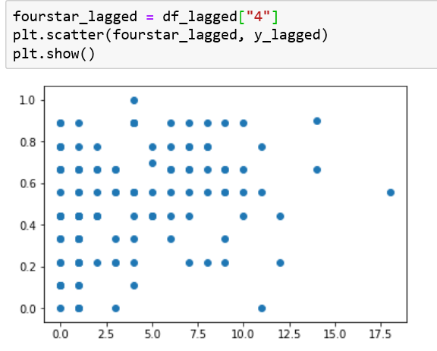
THE ANALYSIS – 3rd Year Impact
3 year impact of recruits, separated by recruiting grade, we can conclude there still

Slide 8
Conclusions
There was no relevant correlation between a team’s WIN% and the higher starred recruits it had in its recruiting class
The findings can be used to suggest a better use for the university funding put into recruiting athletes
OR the structure in place for analyzing athletes should be open to reconstruction
Further analysis can be made on a division to division scale to confirm or broaden our findings

